Slide 1
DISTRICT HEATING AND COOLING IN SMART CITIES - The Lund case
November 24th, 2015
Liisa Fransson, PhD
R&D Manager
Kraftringen Energi AB

Slide 2
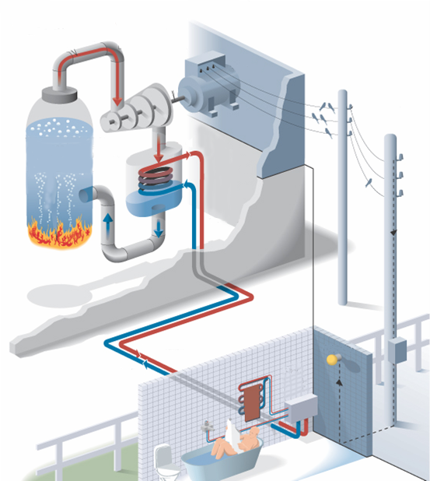
District heating in Sweden
Available in most Swedish municipalities
In total approx 50 TWh/yr
Accounts for more than half of all heating for homes and other premises in Sweden – and approx 90% of multi-family houses are heated by district heating

Slide 3
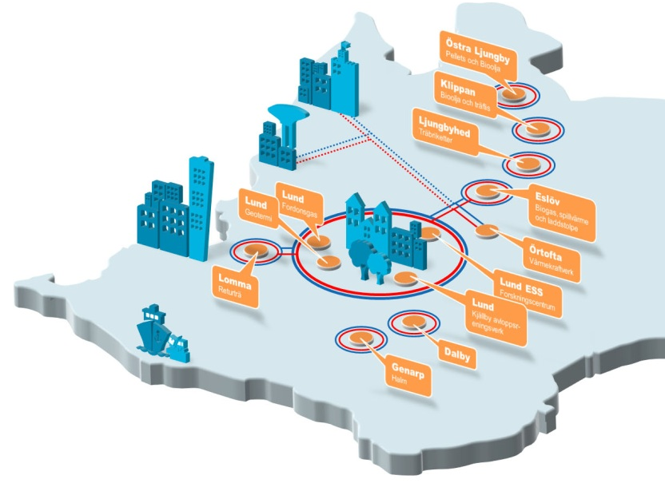
Kraftringen´s district heating story began in 1953
Delivery to the hospital and the university campus
In 1963, first delivery to consumers
Today 1.000 km of piping
1100 GWh p.a.
7.500 customers, serving 55.000 households

Slide 4
The journey towards being fossile free in 2020
Renewable or recovered heat sources
Other sources

Slide 5
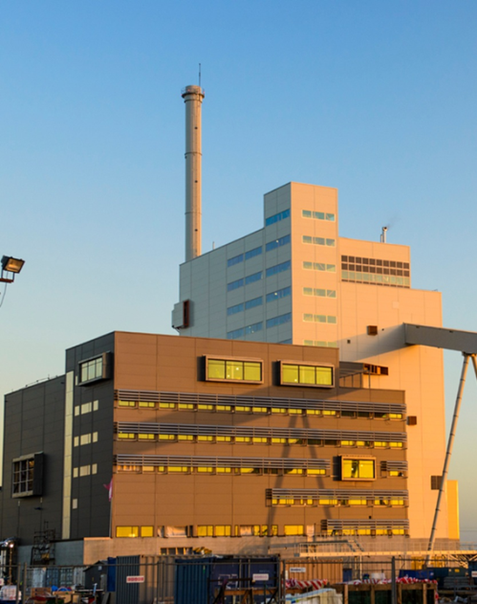
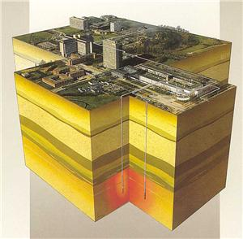
Three examples
Max IV Laboratory: Kraftringen supplies cooling and
recycles the waste heat as district heating
“Research heats the city!”
Örtoftaverket – a combined heat and power plant. In operation since 2014.
Biofuelled
71 MW heat and 39 MW electricity
The world´s largest geothermal energy system.
In operation since 1985
Has covered 25% of the city´s heating demand.

Slide 6
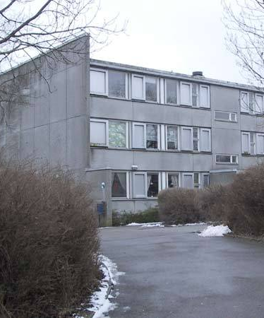
District Heating in CITyFiED – the Linero district
Districtheating for SMART
CITIES
District heating has been available since the area was built in the 1970s
New substations – reduces energy loss
Installation of Smart district heating

Slide 7
Thank you
Liisa Fransson, liisa.fransson@kraftringen.se
www.kraftringen.se

